Slide 1
Project B04

Slide 2
BASIC 4 Describe a house.
You and your partner are going to ask questions to the realtor about the house.
Objectives:
how many, is there, are there. Description of rooms, numbers, colors and prepositions of place.

Slide 3
Remember *to get 3 points, you must be fluent (to your level), *bring visual material (maybe pictures of the house or a big floor plan of the house) *do not read during the

Slide 4
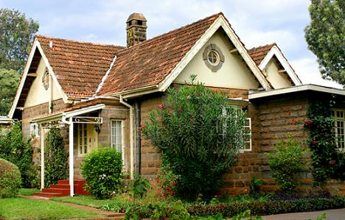
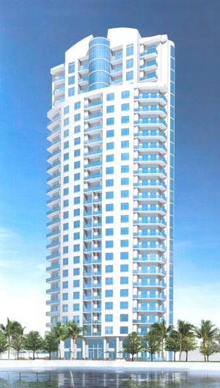
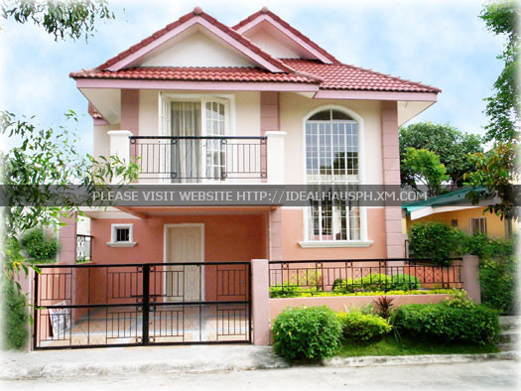

Slide 6
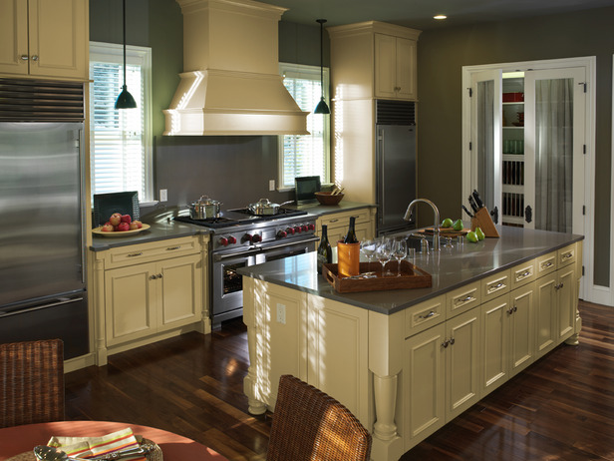

Slide 7
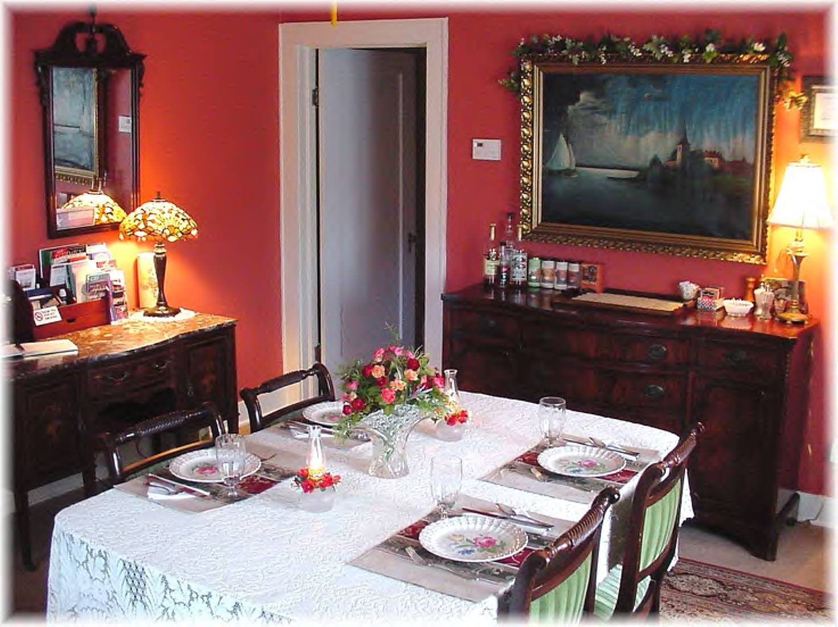

Slide 8


Slide 9
